Slide 1

COMP90050
Advanced Database Systems
Winter Semester, 2023
Lecturer: Farhana Choudhury (PhD)
Week 4 part 6

Slide 2
Specialised databases: Data Warehousing

Slide 3
Data Warehousing
Corporate decision making requires a unified view of all organizational data, including historical data
A data warehouse is a repository (archive) of information gathered from multiple sources, stored under a unified schema, for analytics and reporting purposes
    Greatly simplifies querying, permits study of historical trends
    Shifts decision support query load away from transaction processing systems

Slide 4
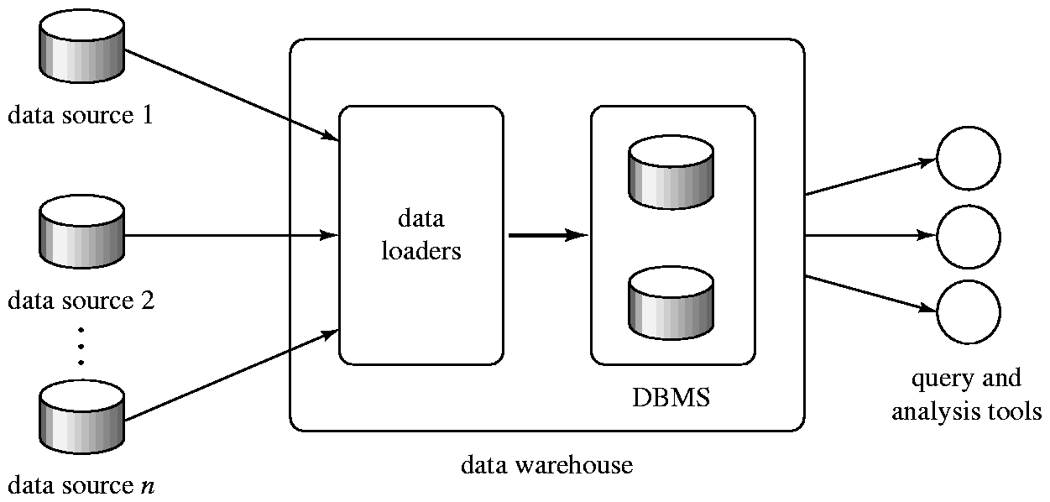
Data Warehousing

Slide 5
Design Issues
When and how to gather data:
  Source driven architecture: data sources transmit new information to warehouse, either continuously or periodically (e.g. at night)
  Destination driven architecture: warehouse periodically requests new information from data sources
  Keeping warehouse exactly synchronized with data sources (e.g., using two-phase commit) is too expensive
    Usually OK to have slightly out-of-date data at warehouse
    Data/updates are periodically downloaded form online transaction processing (OLTP) systems (most of the DBMS work we have seen so far)

Slide 6
More Warehouse Design Issues
What schema to use
  Depends on purpose
  Schema integration
Data cleansing
  E.g. correct mistakes in addresses (misspellings, zip code errors)
  Merge address lists from different sources and purge duplicates
How to propagate updates
  The data stored in a data warehouse is documented with an element of time, either explicitly or implicitly
What data to summarize
  Raw data may be too large to store
  Aggregate values (totals/subtotals) often suffice
  Queries on raw data can often be transformed by query optimizer to use aggregate values

